Slide 1
Reliable Electronics
By
Abhishek Sukhadiya (20076)

Slide 2
Reliable Electronics Background
Located in the Boston City.
Top producer of Electronic & Testing equipments.
Multiple plants with around 10,000 Full-time employees
Around 200 employees in Maintenance department.
Notes:
Maintenance has assigned a group of employees to provide maintenance for each building or plant. Maintenance Department- Carpenters, Electricians, Painters, Welders, Plumbers, Special Skills, etc.

Slide 3
RE Problem Statement
Equipment Depot Operations
Material Warehouse Operations.
Notes:
In September of 2018, Will Baxter and his management staff completed a 1-week analysis aimed at assessing the maintenance operations. The most important initiatives were- …… The equipment depot's function is to provide the equipment needed by maintenance employees to perform their job duties. Employees are provided with a toolbox containing commonly used and relatively inexpensive tools, such as hammers, screwdrivers, tape measures, and so on. Other tools and pieces of equipment that are needed to complete a job must be checked out through the equipment depot. When the job is completed, the employee must return the checked-out equipment.
Often, pieces of equipment become lost, stolen, or damaged and are therefore never checked back in and made available for others. The net result is excessive inventory and inventory carrying costs due to excessive order placed by the employees without checking the availability of the equipments in the Main Warehouse.

Slide 4
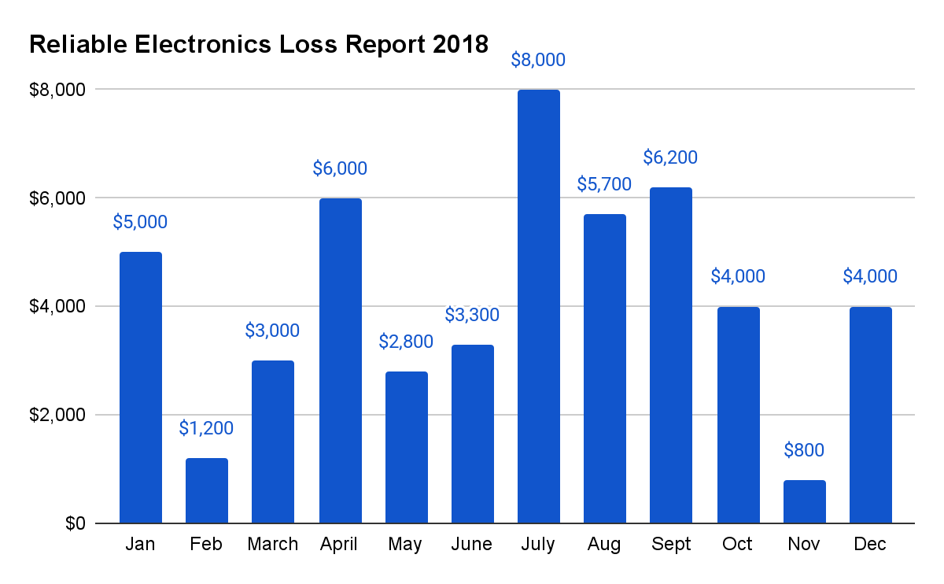
Notes:
The dollar amount of lost and stolen equipment has reached an alarming total. It has been estimated that more than $50,000 worth of tools are lost or stolen each year.

Slide 5
Proposed Solution
Automated Equipment Checkout System
Improved Warehouse System
Notes:
development of a new, automated equipment checkout system that will track the check-in and check-out of equipment. a new and improved warehousing system is another top priority for the maintenance department.

Slide 6
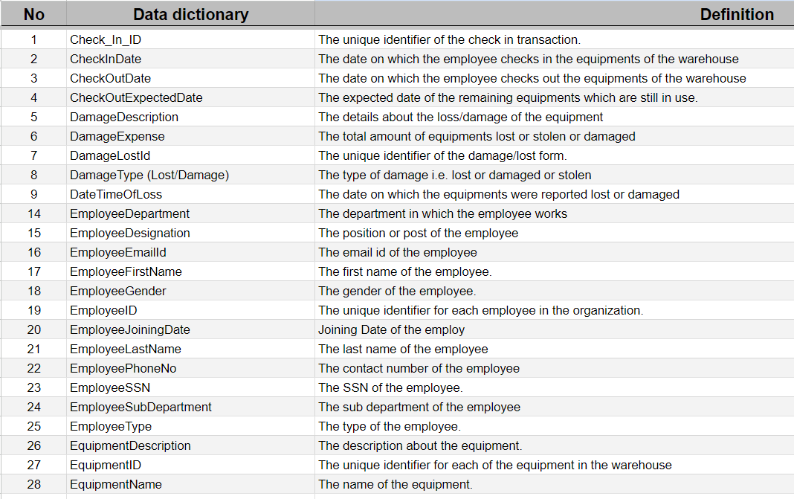
Data Dictionary
Notes:
development of a new, automated equipment checkout system that will track the check-in and check-out of equipment. a new and improved warehousing system is another top priority for the maintenance department.

Slide 7
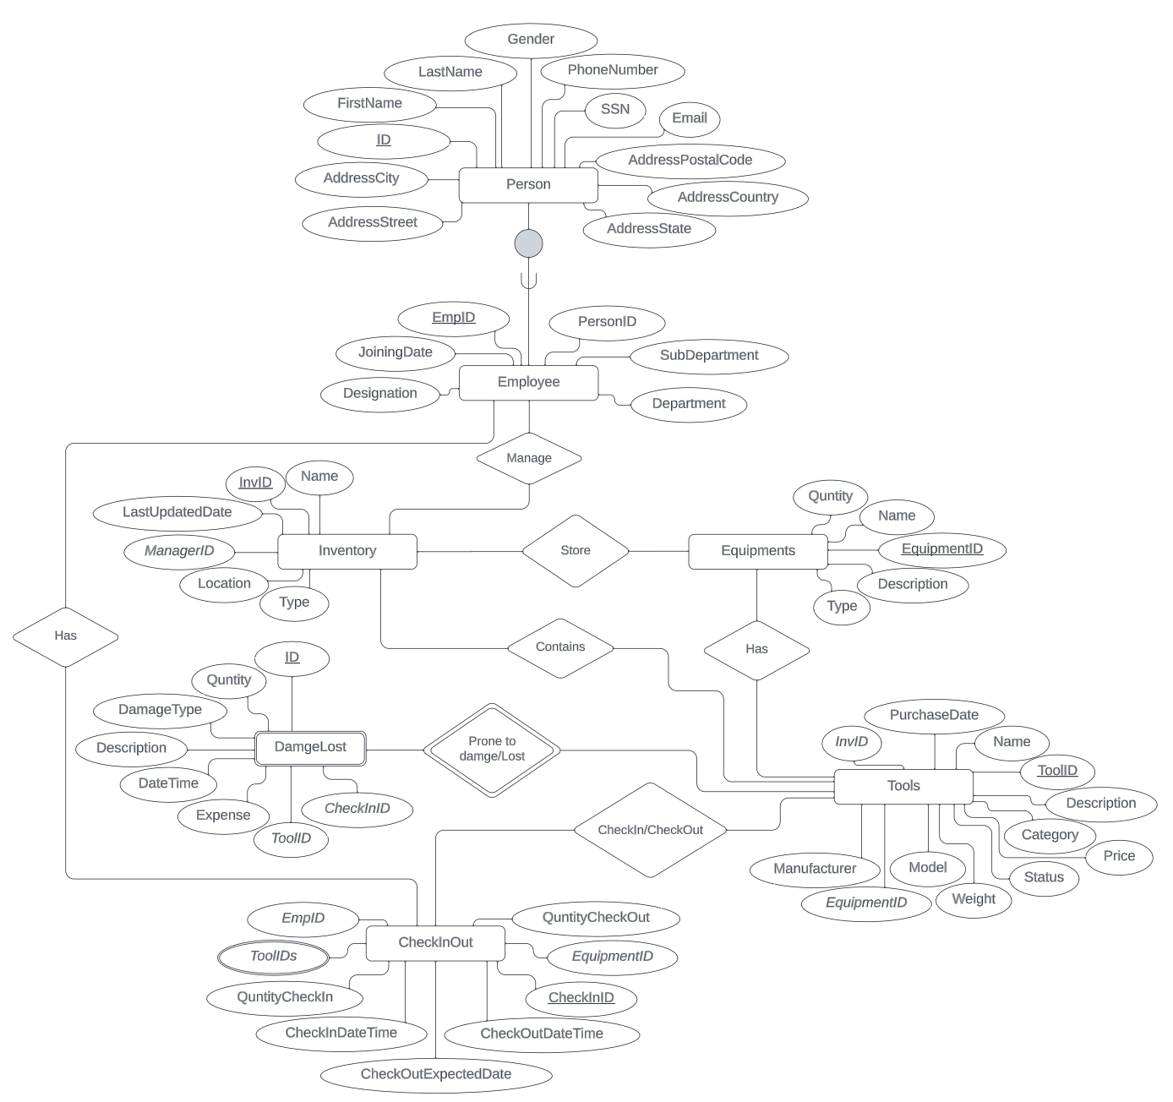
Proposed ER Diagram

Slide 8
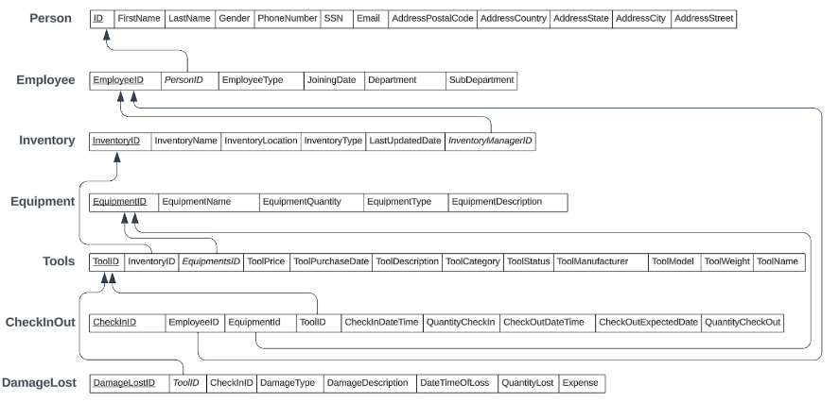
Proposed Relational Schema

Slide 9
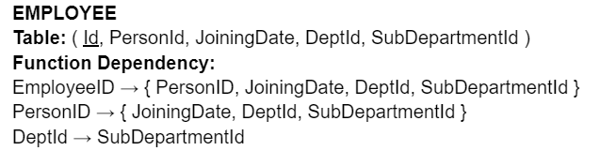
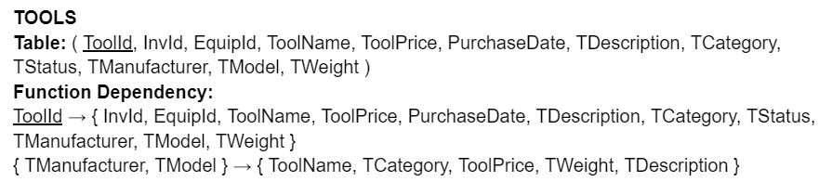
Functional Dependency

Slide 10
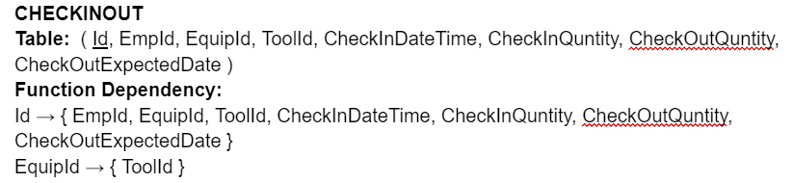
Functional Dependency

Slide 11
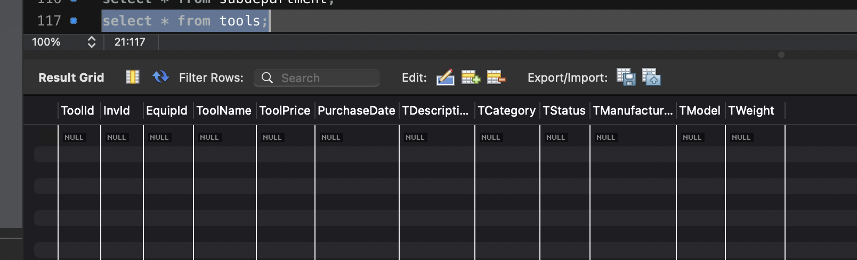
Normalization
Before Normalization

Slide 12
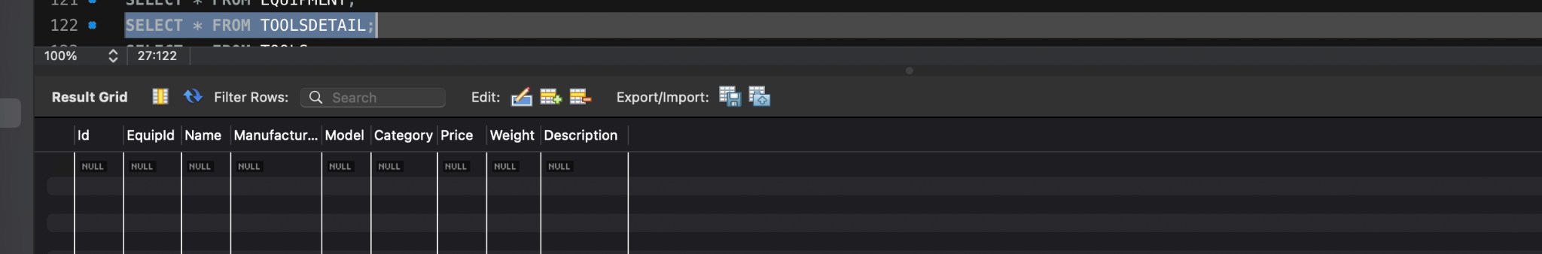
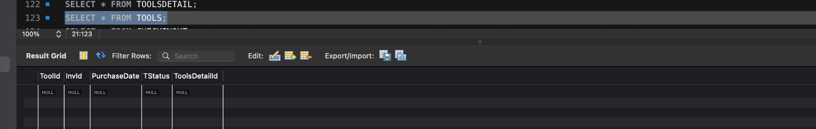
Normalization
After Normalization

Slide 13
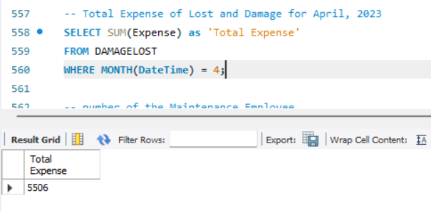
April 2023 Expense Details

Slide 14
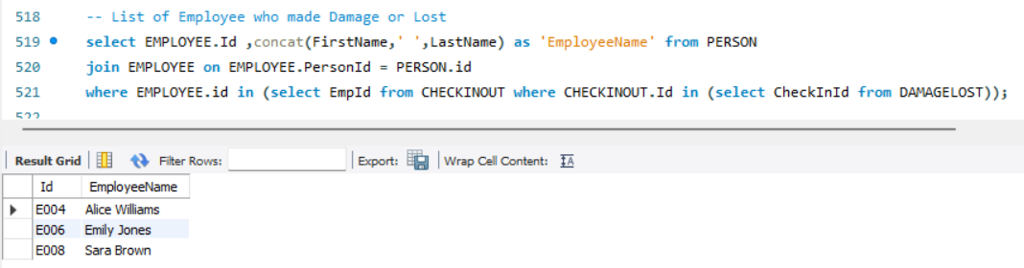
List of Employees who Lost/Damaged tools

Slide 15
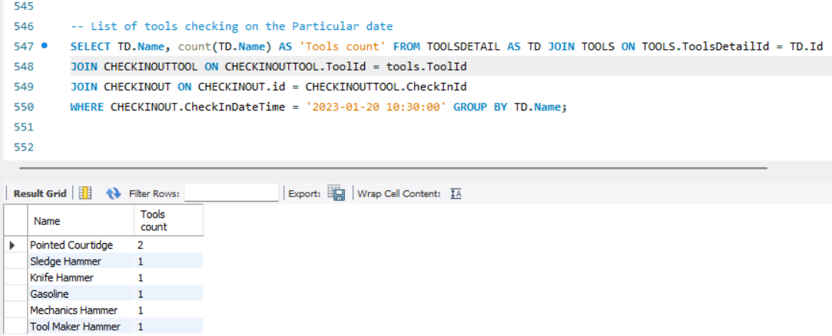
Tools Check-in Count on a particular date

Slide 16
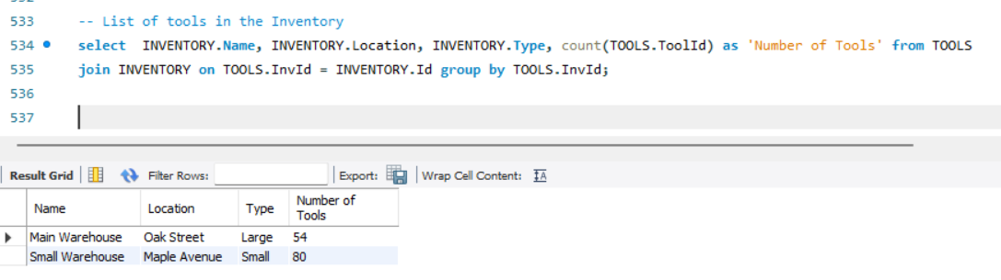
List of tools in the Inventory

Slide 17
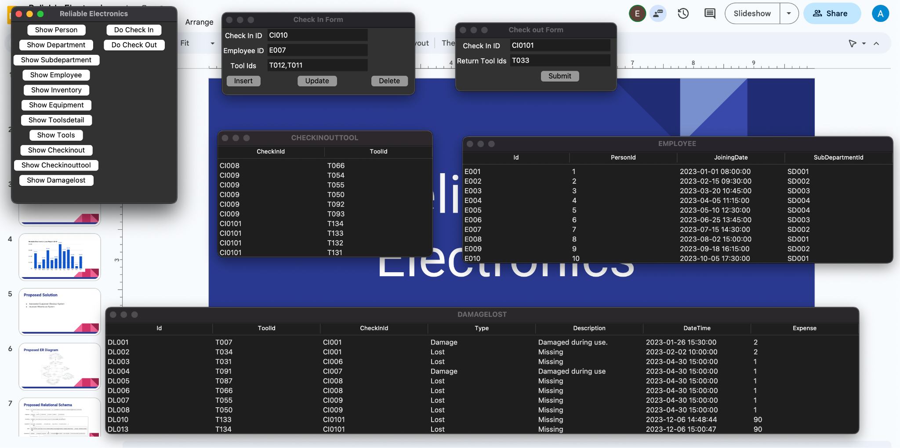
GUI of Reliable Electronics

Slide 18
Challenges and Learnings
Challenges faced-
Deciding on what all tables we actually needed to implement.
Data entry for tools and the category of the tools which are need during the maintenance.
Multiple table connection with cascade operation.
Learnings-
Clarity about implementation of Functional Dependency & Normalization
Integration of Database with Python and GUI.

Slide 19
Conclusion
Automated Equipment Checkout System-
Better tracking of tools and equipments
Reduced loss/damage of tools and equipments
Enhanced Warehouse System-
Controlled equipment expenses
Streamlined equipments’ order

Slide 20
Q & A

Slide 21
Thank You

